Slide 1
Creative Production Management
Group - 4
1805067, 1805068, 1805077, 1805082, 1805087, 1805093
Notes:
Centralized, digital (automated)

Slide 2
Project Overview
A centralized system for the regulation of creative content production
Client and cost management (ANUP)
Task delegation and assignment (ANUP)

Slide 3
Motivation
The process involving the demand and production of creative content is very tedious and primitive
No suitable platform uniting the client and the organization of content creators is available

Slide 4
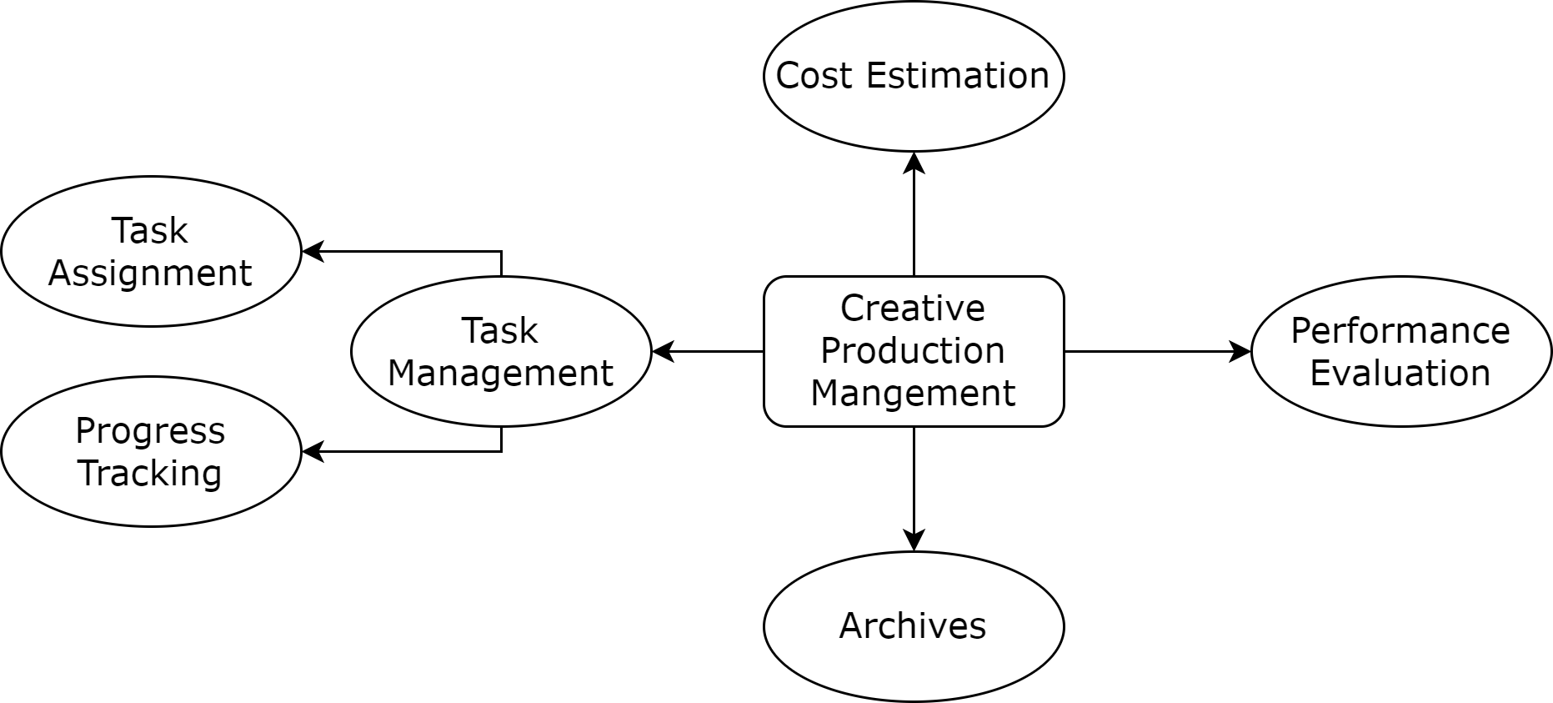
Modules
Cost Estimation
Task Management
Archive Management
Performance Analysis

Slide 5
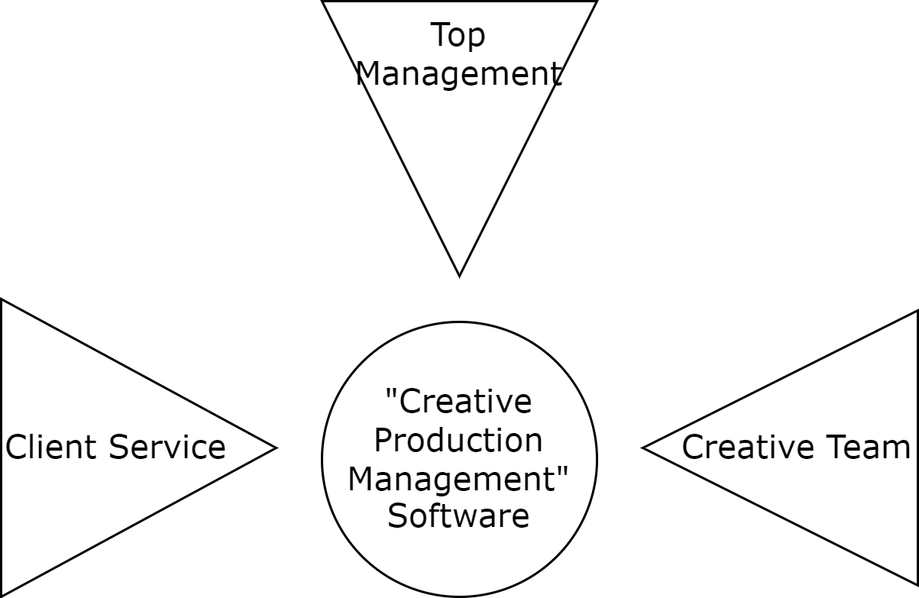
Roles
Top Management
Client Service
Creative Team

Slide 6

Flow of Control

Slide 7
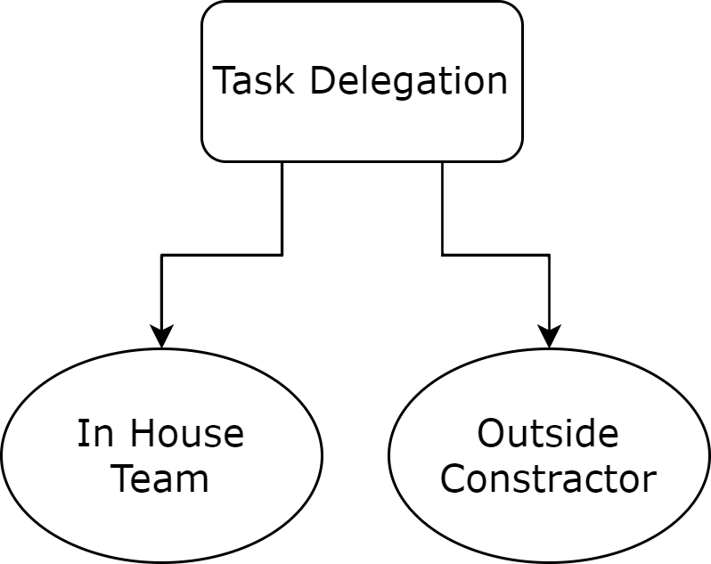
Task Delegation

Slide 8
Cost Estimation
In House Development
Requirements breakdown
Specific cost according to certain types of works
Manual cost input of new types of works
Vendors
Cost Estimation taken from the outside contractor
Costs would be finalized upon client’s approval.
Notes:
Rate of predefined fields
Manual cost input of new fields

Slide 9
Cost Estimation
In-House Assignment
Requirements breakdown
Work-specific cost (with manual inclusion of new types)
Vendors
Cost Estimation taken from the outside contractor
Costs would be finalized upon client’s approval.
Notes:
Rate of predefined fields
Manual cost input of new fields

Slide 10
Task Management
In House Task Assignment
Client Service Officer would assign tasks based on the load of all designers and their expertise.
Tasks assigned to Vendors
A work order will be generated mentioning the details of the task and the cost agreed by both the client and the vendor.

Slide 11
Task Management
In-House Task Assignment
Assignment of tasks based on the load and expertise of the designers by Client Service.
Tasks assigned to Vendors
Generation of work order according to prior agreement.
Progress Tracking
Role-specific dashboards for tracking progress and deadline information.

Slide 12
Task Management
Progress Tracking
A dashboard will be in place for keeping track of ongoing tasks with their deadline.
Top Management and Client Service can observe the progress of the ongoing tasks throughout the organization.
Members of the Creative Team can observe the progress of their own tasks.
Tasks outsourced to Vendors will also show up in the dashboard.
Tasks exceeding deadlines will be displayed in different color in the dashboard.

Slide 13
Task Management
Progress Tracking
Role-specific dashboards for tracking progress and deadline information.

Slide 14
Archive Management
Client Service Officers (CSO) are in charge of Archives.
Upon receiving a content from the creative team, CSO will add that to the archives after inclusion of necessary metadata.
CSO can rate the creative contents.
Creative Team has the ability to search extensively through the archive for inspiration.

Slide 15
Archive Management
Completed contents archived by Client Service for future references
Archived along with important metadata regarding related task and rating

Slide 16
Performance Evaluation
Top Management and Client Service will be able to see th evaluate the performance of the individual members of the Creative Team based on their volume of work against time required and the quality of work.

Slide 17
Performance Evaluation
Review of performance according to work per time and quality of completed work

Slide 18


Related examples
slack
Notes:
ANUP ICON LAGA

Slide 19
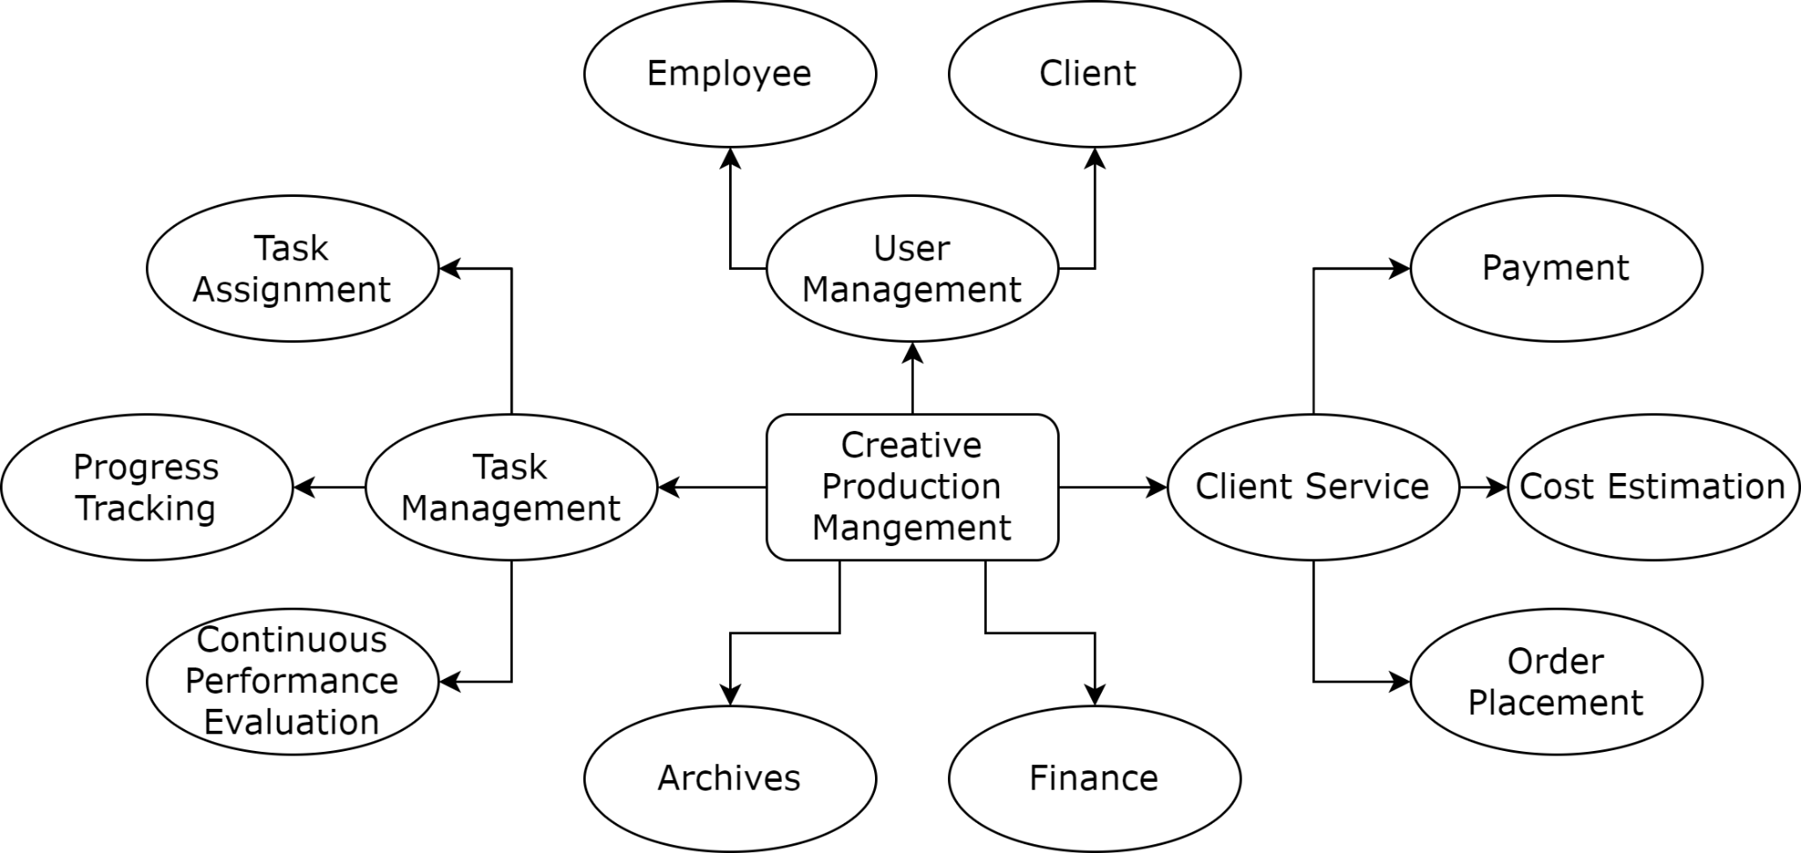
Modules
Notes:
Task management - task assignment, progress tracking, continuous performance analysis
Client service - payments, cost estimation, order
Finance
Archives - files, rating

Slide 20
Order Placement
Taking orders from clients through a well defined form.
Orders taken at different rates depending on the type of customers.

Slide 21
Payment
Retainer clients would have a defined cards of standard costs and a personal discount per this type of client.
Ad hoc clients would need to discuss his requirements and negotiate an amount up front or via email.
A Payment Gateway will be in place for receiving payments (advance and final).

Slide 22
Finance
Keeps track of
Payment of already delivered orders
Designers’ salary
Suppliers’ cost
Finalized orders with agreed cost
Calculates
Net profit at the end of a month/year
Estimated profit at the end of a month/year

Slide 23
User Management
Client
Retainer Client
Ad Hoc Client
Designer
Manager

